Slide 1
Machine Learning DSECL ZG565
Dr. Monali Mavani

Slide 2

Machine Learning
Disclaimer and Acknowledgement
The content for these slides has been obtained from books and various other source on the Internet
I here by acknowledge all the contributors for their material and inputs.
I have provided source information wherever necessary
I have added and modified the content to suit the requirements of the course

Slide 3
Session Content
Linear models for regression
Linear Regression
Linear Regression Cost Function
Learning Model Parameters - Gradient Descent Optimization
Learning Model Parameters – Closed Solution
Linear Basis Function Models
Quality of fit
Evaluation metrics

Slide 4
Closed Form Solution

Slide 5
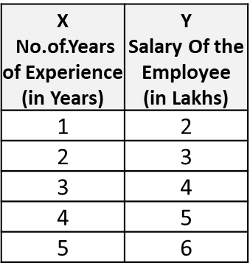
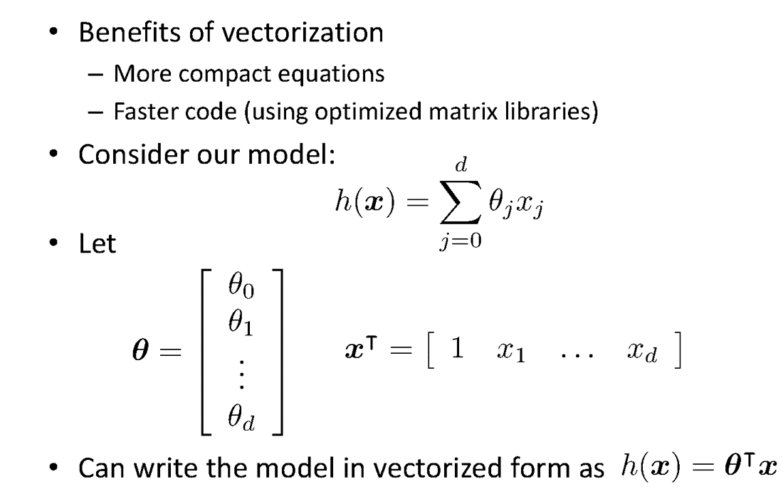
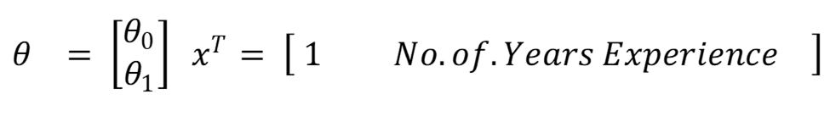
Vectorization

Slide 6
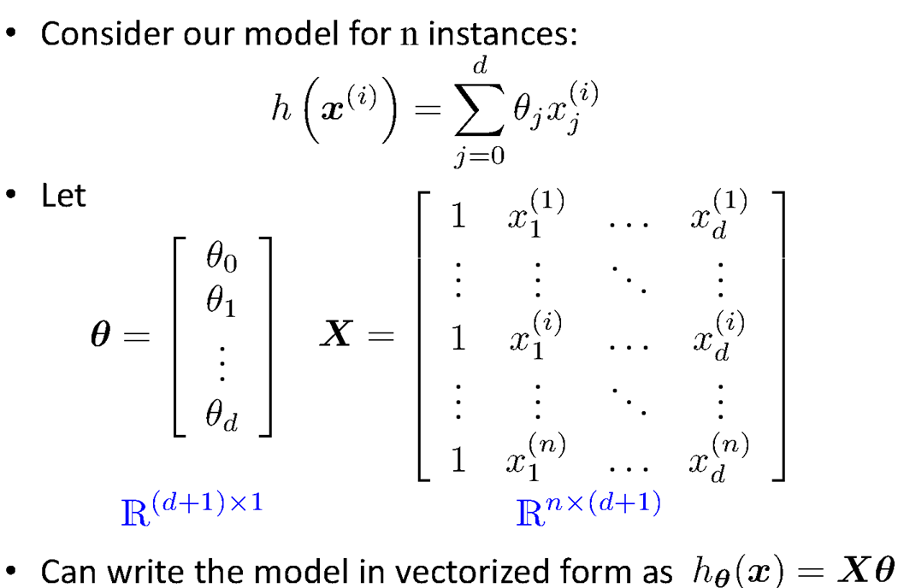
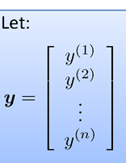
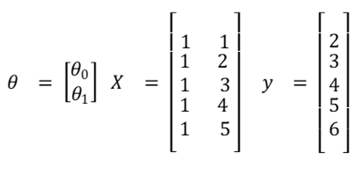
Vectorization

Slide 7
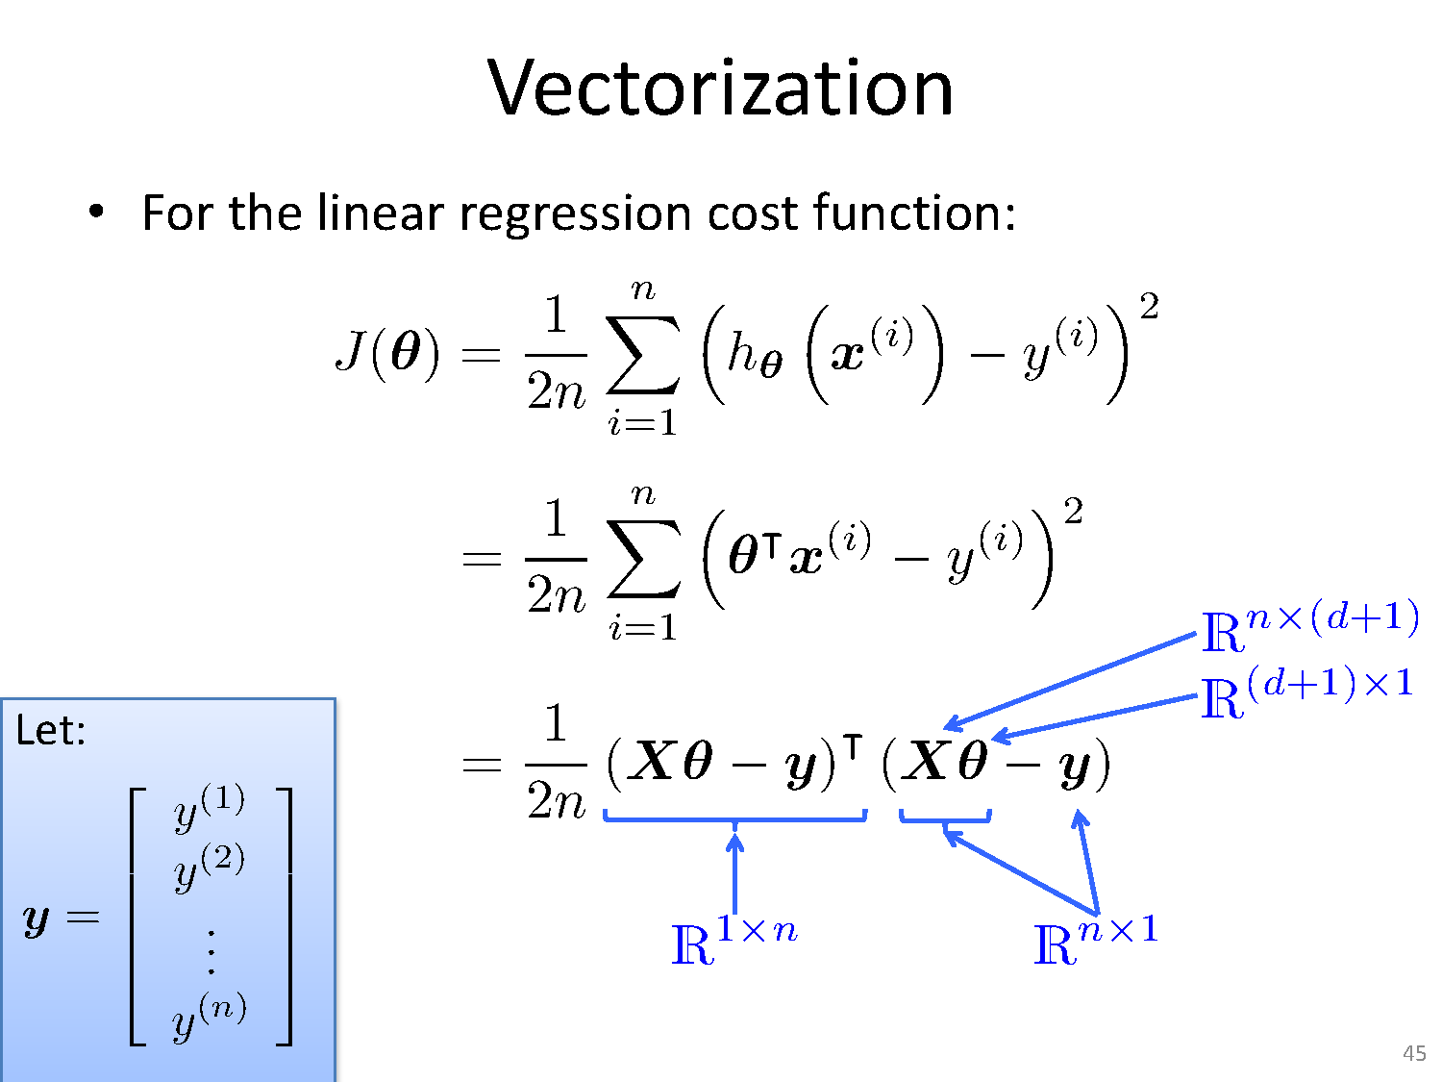

Slide 8
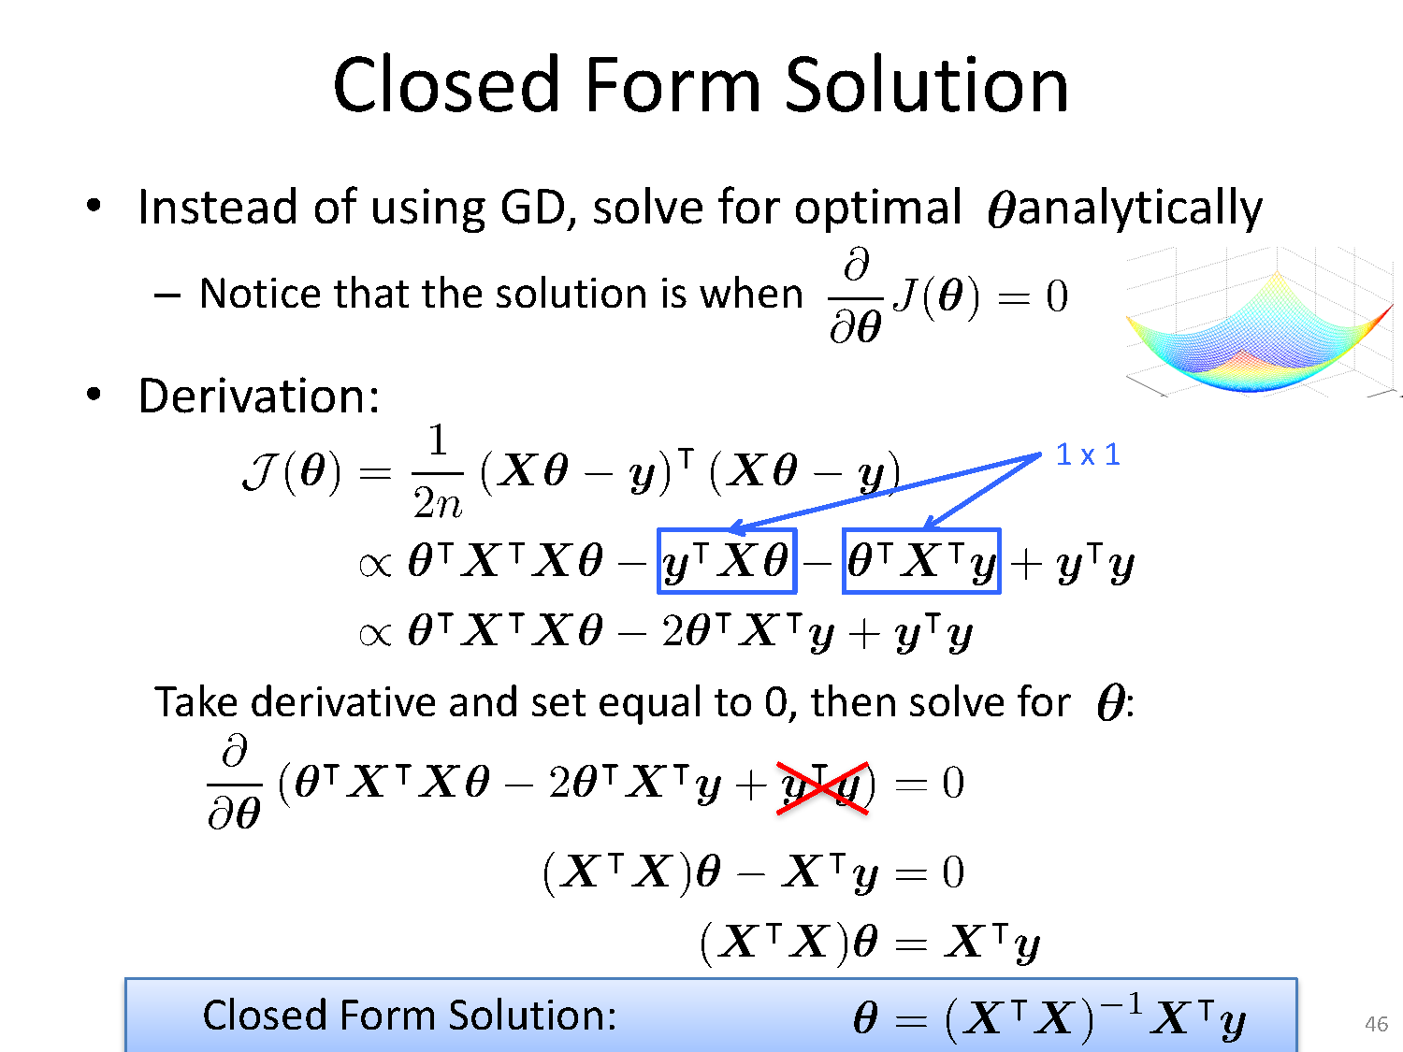

Slide 9
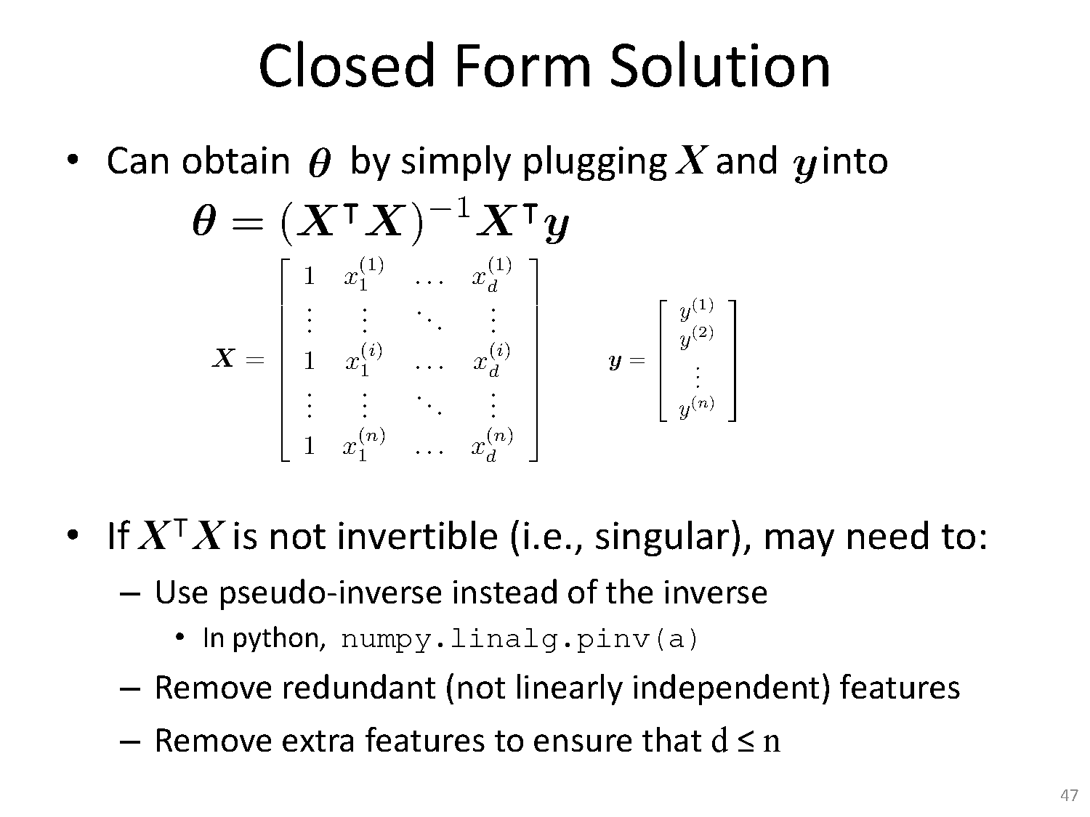

Slide 10
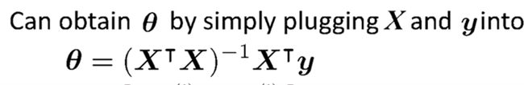
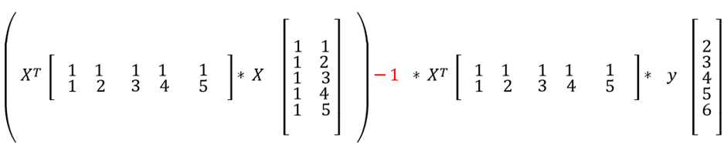
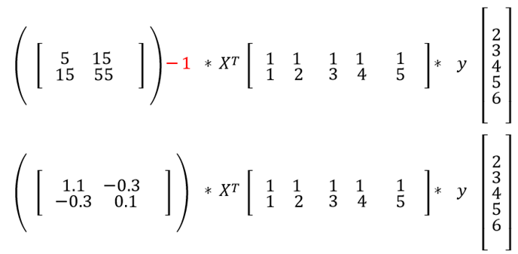
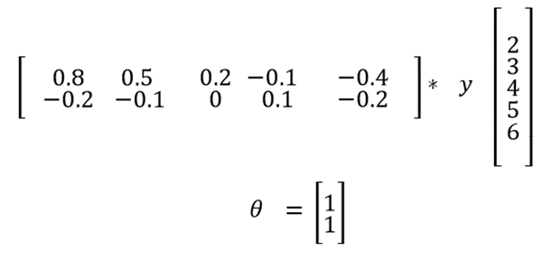
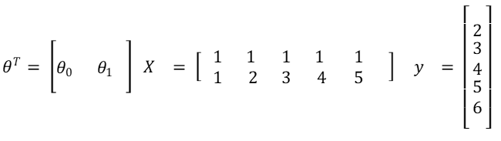
Fit the Linear Regression Model :
Using Closed Form

Slide 11
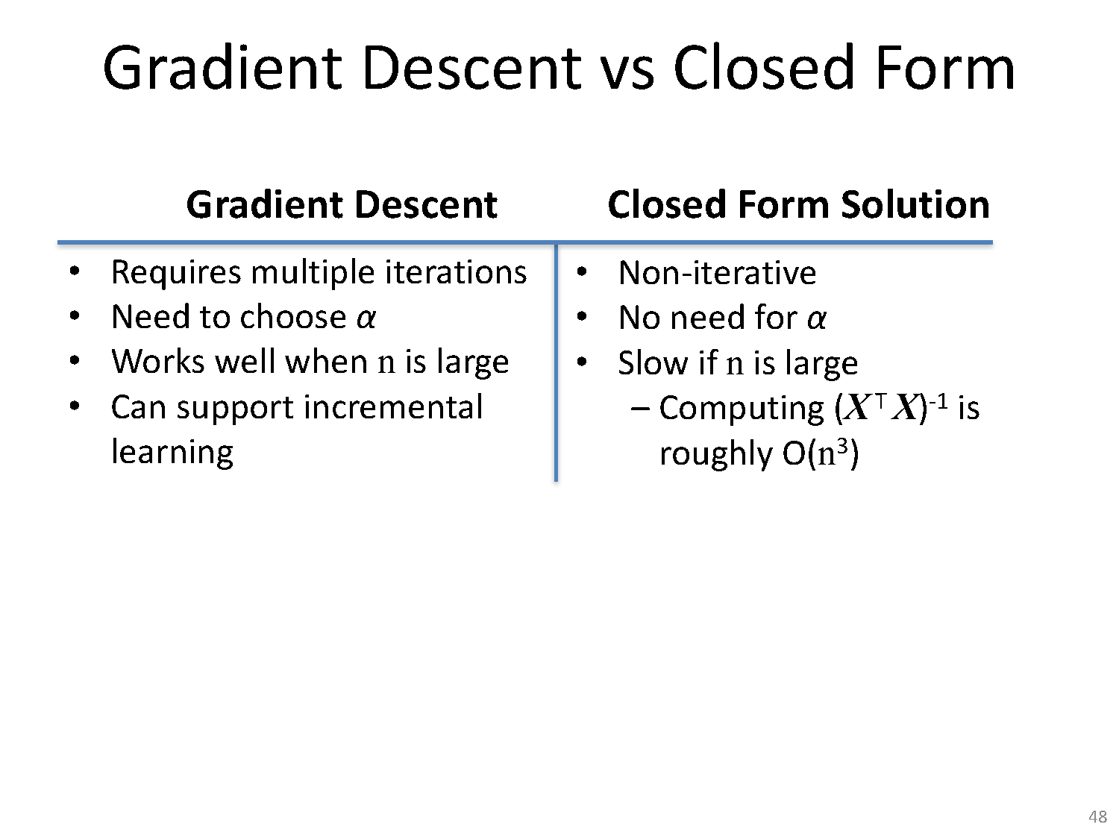

Slide 12
Linear Basis Function Models

Slide 13
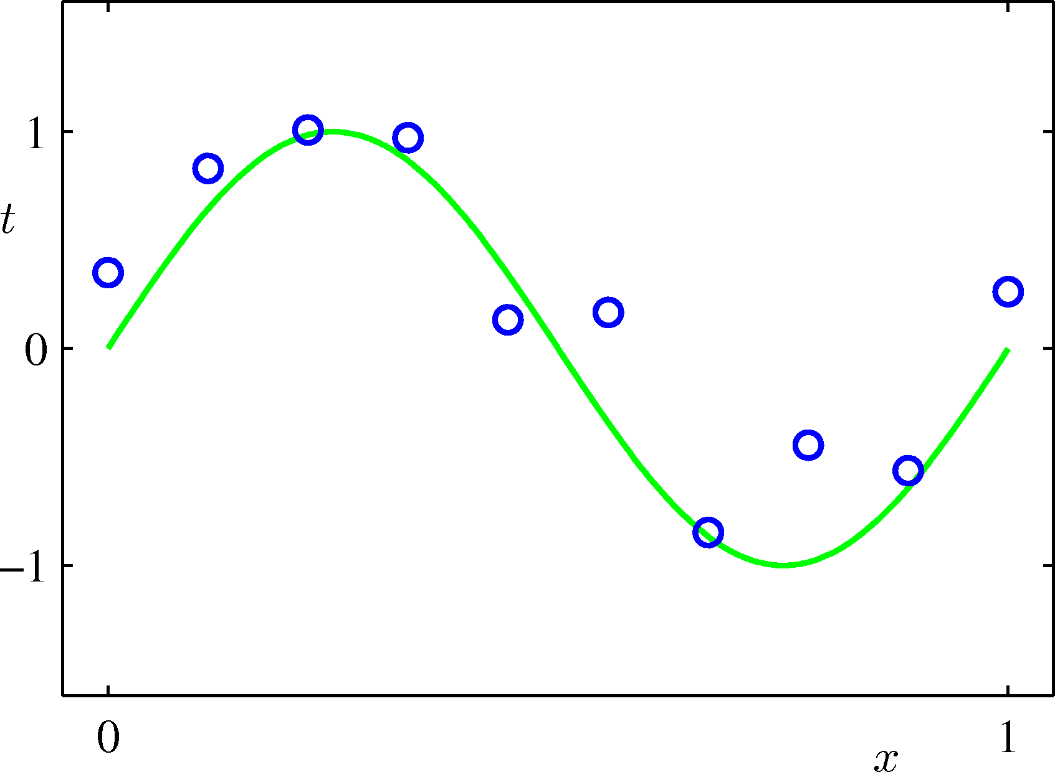
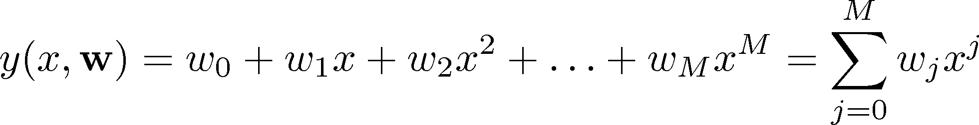
Linear Basis Function Models
Example: Polynomial Curve Fitting

Slide 14
Linear Basis Function Models
What if our linear model is not good? How can we create a more complicated model?
We can create a more complicated model by defining input variables that are combinations of components of x
Example: an M-th order polynomial function of one dimensional feature x :
where x^{j} = j-th power of x

Slide 15
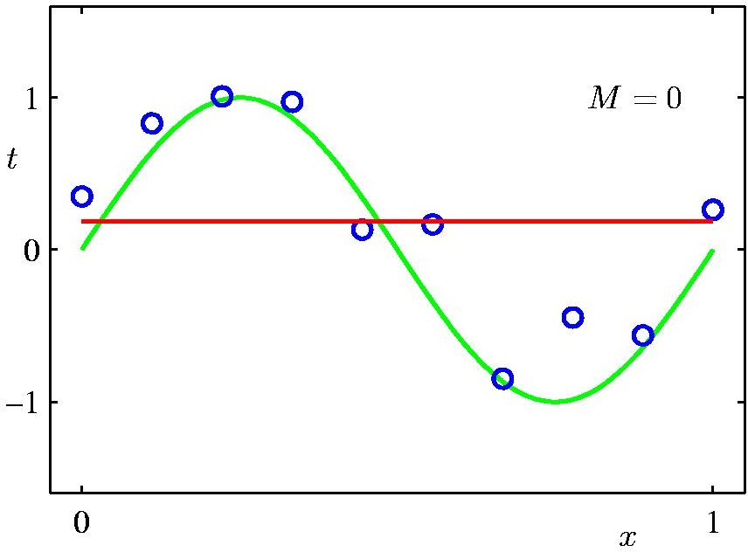
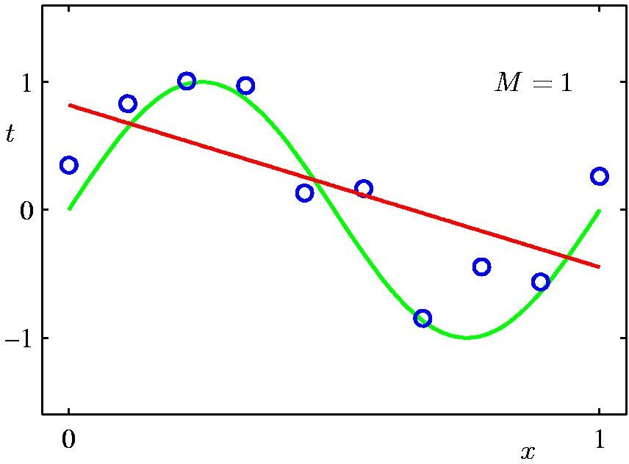
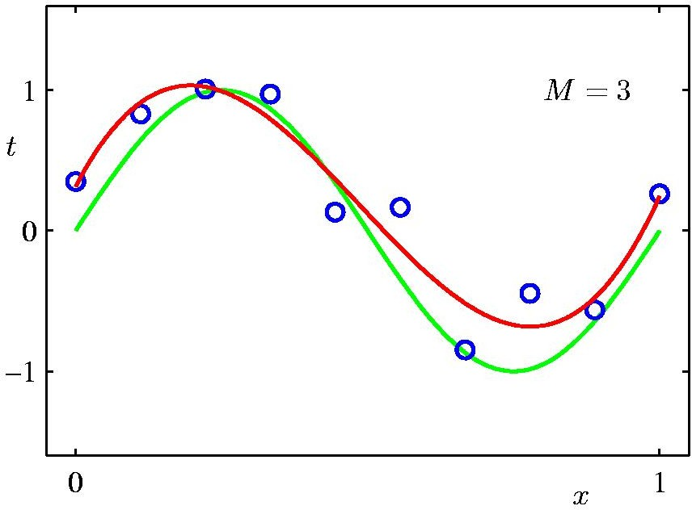
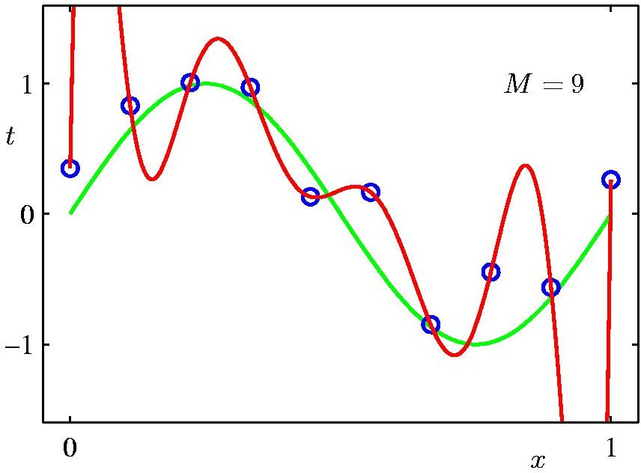
Polynomial Regression
17 / 22

Slide 16
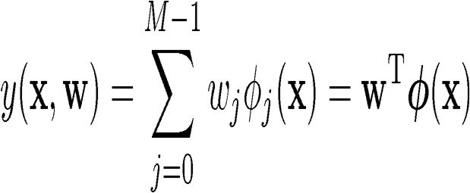
Linear Basis Function Models
Generally
where Φ_{j}(x) are known as basis functions. Typically, Φ₀(x) = 1, so that w₀ acts as a bias.
In the simplest case, we use linear basis functions : Φ_{d}(x) = x_{d}.
By using nonlinear basis functions, we allow the function y(x,w) to be a nonlinear function of the input vector x.
They are called linear models because this function is linear in w

Slide 17
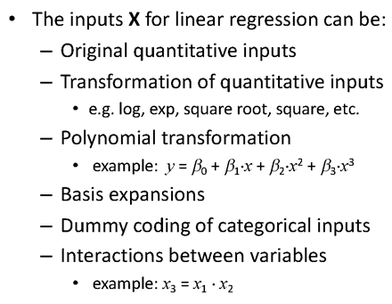

Extending linear regression to more complex models

Slide 18
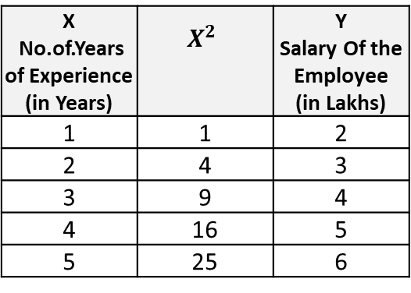

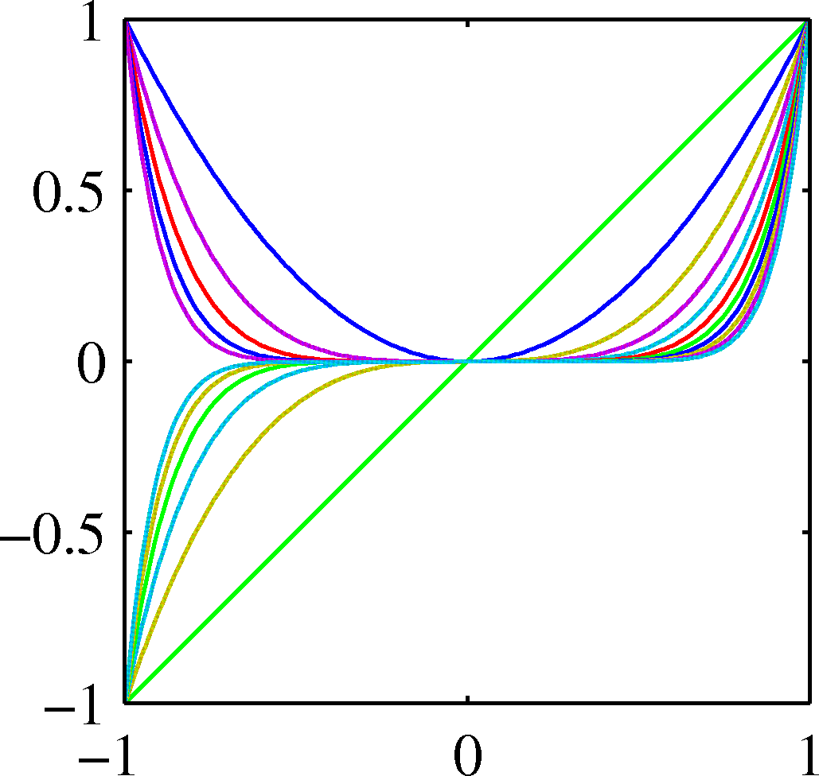
Linear Basis Function Models
Polynomial basis functions:
These are global; a small change in x affect all basis functions.

Slide 19
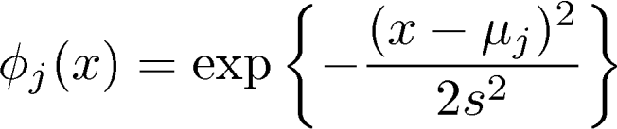
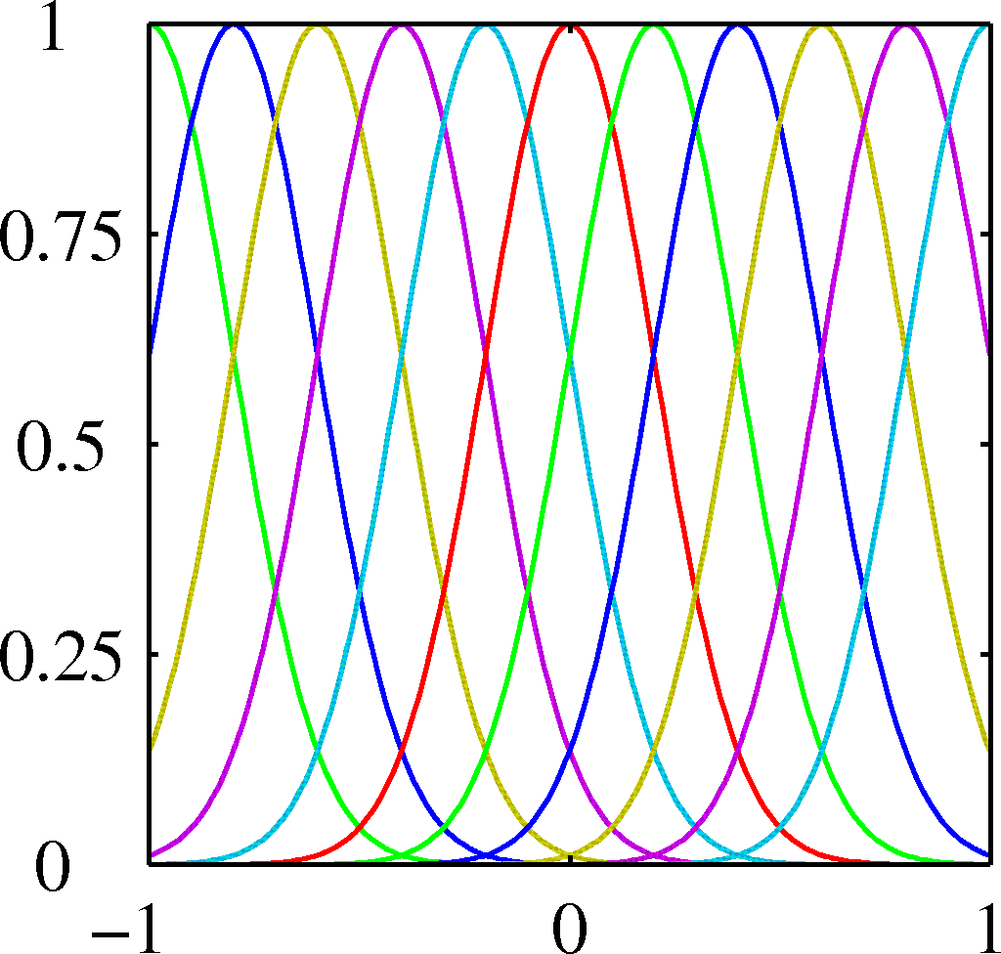
Linear Basis Function Models
Gaussian basis functions:
These are local; a small change in x only affect nearby basis functions. µ_{j} and s control location and scale (width).

Slide 20
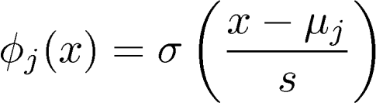
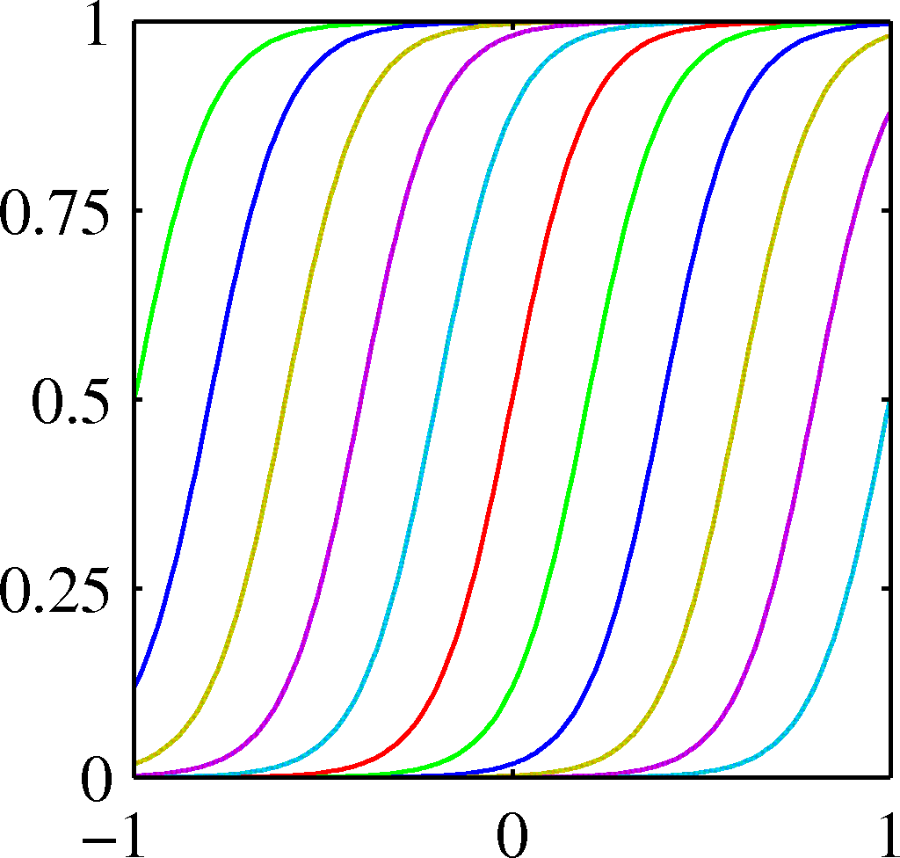
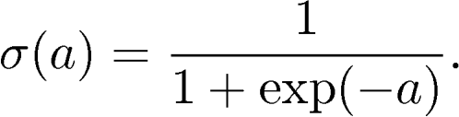
Linear Basis Function Models
Sigmoidal basis functions:
where
Also these are local; a small change in x only affect nearby basis functions. µ_{j} and s control location and scale (slope).

Slide 21
Evaluation metrics

Slide 22



MSE, RMSE, MAE
Case 1: Actual Values = [2,4,6,8] , Predicted Values = [4,6,8,10] Case 2: Actual Values = [2,4,6,8] , Predicted Values = [4,6,8,12]
MAE for case 1 = 2.0, RMSE for case 1 = 2.0 MAE for case 2 = 2.5, RMSE for case 2 = 2.65
if you want to penalize your bad predictions too much, you can use MSE evaluation metric
if your data have too much outlier MSE give too much penalty to this examples, MAE is robust to outliers
RMSE/MSE is still the default metric of many models because loss function defined in terms of RMSE is smoothly differentiable and makes it easier to perform mathematical operations

Slide 23

MAPE
MAPE is expressed as a percentage, which makes it a scale-independent metric
MAPE can exceed 100%

Slide 24

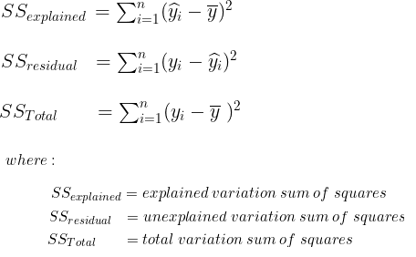
R-squared
variation in ‘y’ that is explained by a regression model
Mileage (in kmpl) | Car Price (in cr)
9.8 | 10.48
9.12 | 1.75
9.5 | 6.95
10 | 2.51
…. | …..
Car Price (in cr)
10.48
1.75
6.95
2.51
Mean Y
variation in ‘y’ that is not captured/explained by a regression model
Model 1
CarPrice = 8.5 + 0.5 Mileage – 1.5 Mileage²
variation that is explained by a regression model
measures the goodness of fit of a regression model

Slide 25
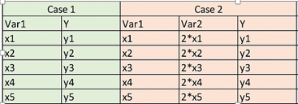
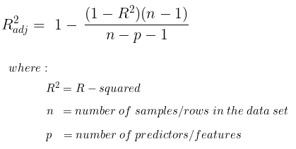
R-squared/Adjusted R-squared
R² corresponds to the degree to which the variance in the dependent variable (the target) can be explained by the independent variables (features).
A higher value indicates a better fit
Drawback of R² is that it assumes that every feature helps in explaining the variation in the target
Adjusted R², which additionally penalizes adding features that are not useful for predicting the target. The value of the adjusted R² decreases if the increase in the R² caused by adding new features is not significant enough.
Adjusted R² → always less than or equal to R²

Slide 26
Choosing the metrics
Consider a few of the following questions:
Do you want to measure predictive power of the model? – MSE/RMSE/MAE
Do you expect frequent outliers in the dataset? If so, how do you want to account for them? – MAE if robustness to outliers are required
Do you want a scale-independent metric/ communicate to business people ? –MAPE
Do you want to check how well the data fit the regression model (the goodness of fit)-R² / Adjusted R²
Do you want to compare the models with different numbers of features - Adjusted R²

Slide 27
Quality of fit

Slide 28

Addressing overfitting
$x_{1}=$ size of house
$x_{2}=$ no. of bedrooms
$x_{3}=$ no. of floors
$x_{4}=$age of house
$x_{5}=$average income in neighborhood
$x_{6}=$ kitchen size
$⋮$
$x_{100}$
Price ($) in 1000’s
Size in feet^2

Slide 29
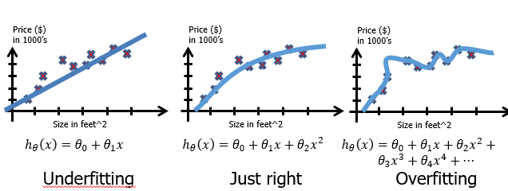
Quality of fit
High bias
extent to which the average prediction over all data sets differs from the desired regression function
High variance
extent to which solutions
for individual data sets vary around their average

Slide 30
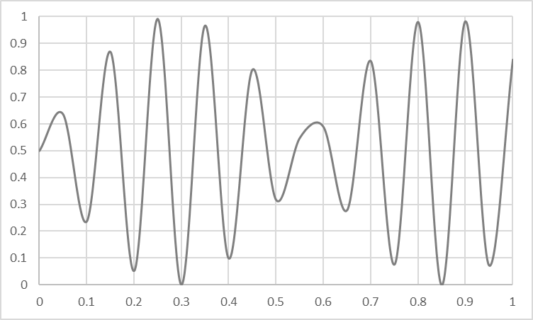
Overfitting vs Underfitting
Overfitting
Underfitting
Fitting the data too well
Features are noisy / uncorrelated to concept
Learning too little of the true concept
Features don’t capture concept
Too much bias in model

Slide 31
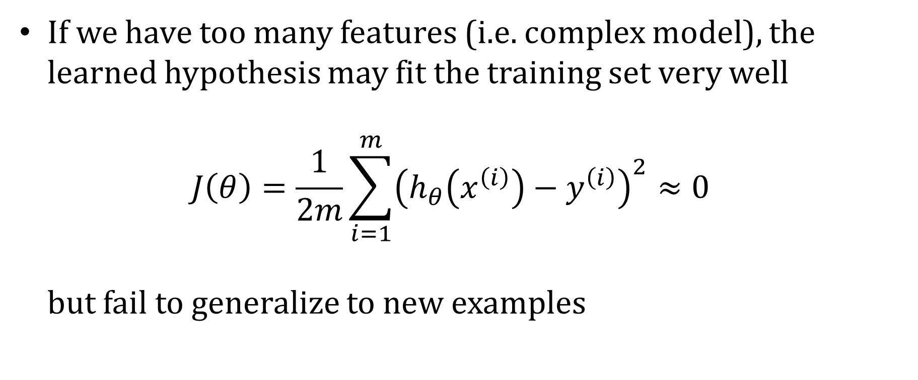
Overfitting
If we have too many features (i.e. complex model), the learned hypothesis may fit the training set very well $J\left(θ\right)=\frac{1}{2m}\sum_{i=1}^{m}{{\left(h_{θ}\left(x^{\left(i\right)}\right)−y^{\left(i\right)}\right)}^{2}}≈0$ but fail to generalize to new examples

Slide 32
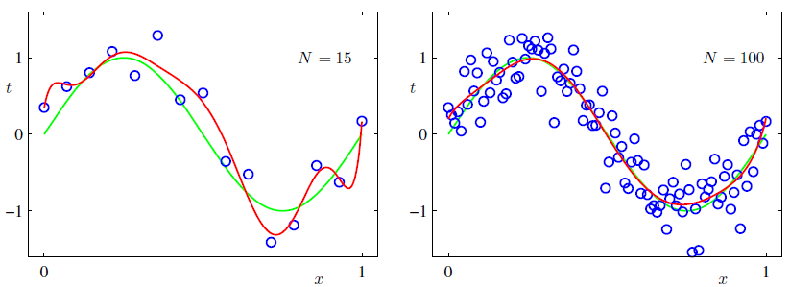
Handling Overfitting – Way 1
Size of the data set reduces the over-fitting problem

Slide 33
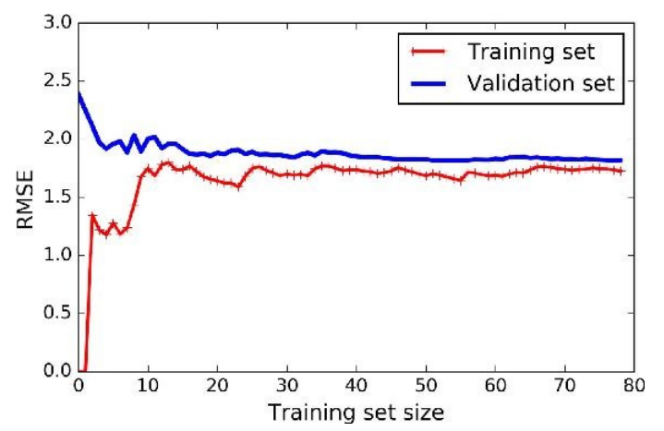
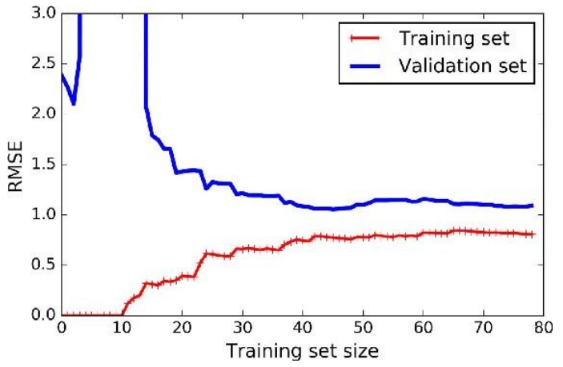
Effect of Training Size on Overfitting
Size of training dataset needs to be large to prevent when higher order model is used.
Higher order model
Lower order model

Slide 34
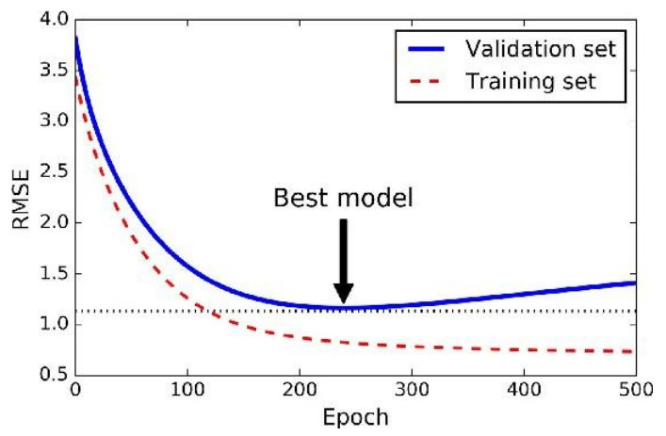
Handling Overfitting – Way 3
Early Stop the Training

Slide 35
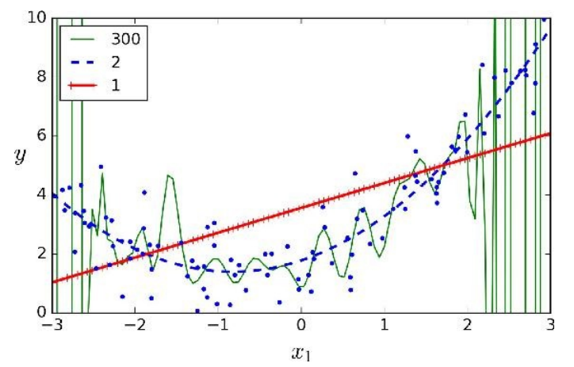
Polynomial Fitting can lead to Overfitting
Handling Overfitting – Way 2 – Reduce the complexity of the model
Underlying target function is quadratic
Linear model results in underfitting with large bias
Polynomial of order 300 results in a large variance

Slide 36
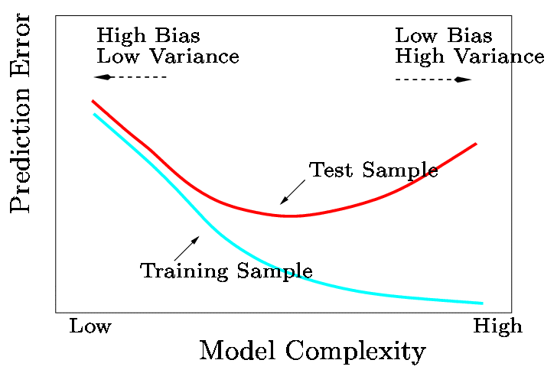
How to experiment on Model Complexity ?

Slide 37
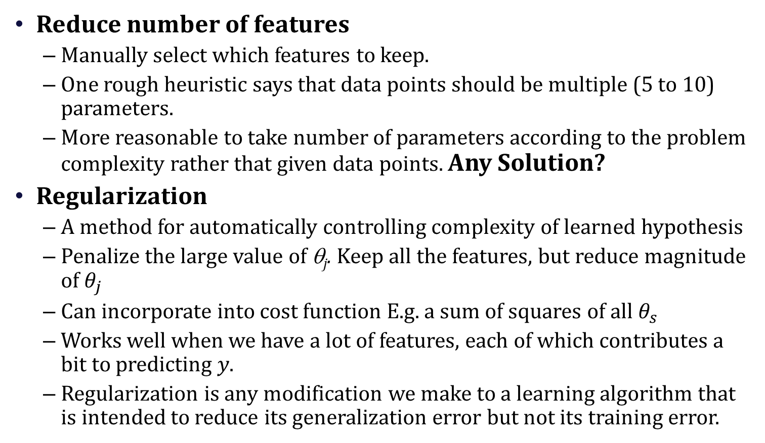
Addressing overfitting
Reduce number of features
Manually select which features to keep.
One rough heuristic says that data points should be multiple (5 to 10) parameters.
More reasonable to take number of parameters according to the problem complexity rather that given data points. Any Solution?
Regularization
A method for automatically controlling complexity of learned hypothesis
Penalize the large value of θ_{j}. Keep all the features, but reduce magnitude of $θ_{j}$
Can incorporate into cost function E.g. a sum of squares of all $θ_{s}$
Works well when we have a lot of features, each of which contributes a bit to predicting $y$.
Regularization is any modification we make to a learning algorithm that is intended to reduce its generalization error but not its training error.

Slide 38
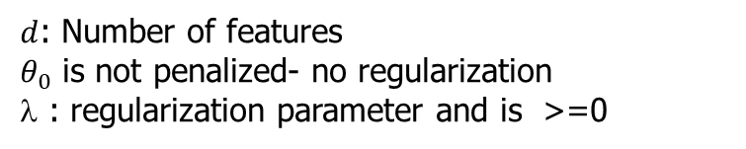
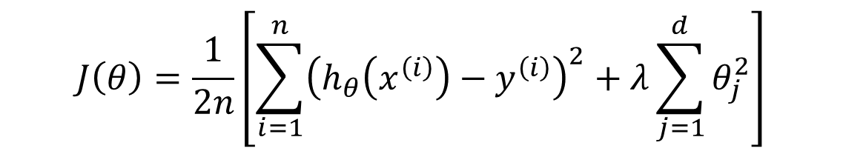
Regularization
Ridge/L2 regularization
loss term : measures how well the model fits the data
regularization term: measures model complexity
$$J\left(θ\right)=\frac{1}{2n}\left[\sum_{i=1}^{n}{{\left(h_{θ}\left(x^{\left(i\right)}\right)−y^{\left(i\right)}\right)}^{2}}+λ\sum_{j=1}^{d}{θ_{j}^{2}}\right]$$
$d$: Number of features
$θ_{0}$ is not penalized- no regularization
λ : regularization parameter and is >=0
λ governs the relative importance of the regularization term compared with the sum-of-squares error term

Slide 39
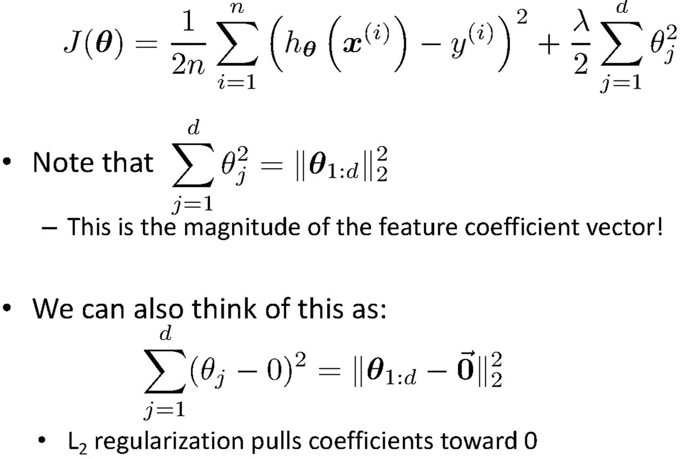
Understanding Regularization

Slide 40


Ridge/L2 regularization
Gradient descent (Regularized)
Repeat {
$$θ_{0} ≔θ_{0}−α\frac{1}{n}\sum_{i=1}^{n}{\left(h_{θ}\left(x^{\left(i\right)}\right)−y^{\left(i\right)}\right)}$$
$$θ_{j} ≔θ_{j}−α\frac{1}{n}\left[\sum_{i=1}^{n}{\left(h_{θ}\left(x^{\left(i\right)}\right)−y^{\left(i\right)}\right)}x_{j}^{\left(i\right)}+λθ_{j}\right]$$
$$θ_{j} ≔θ_{j}(1−α\frac{λ}{n})−α\frac{1}{n}\left[\sum_{i=1}^{n}{\left(h_{θ}\left(x^{\left(i\right)}\right)−y^{\left(i\right)}\right)}x_{j}^{\left(i\right)}\right]$$
}
$1−α\frac{λ}{n}<1$: Weight decay

Slide 41
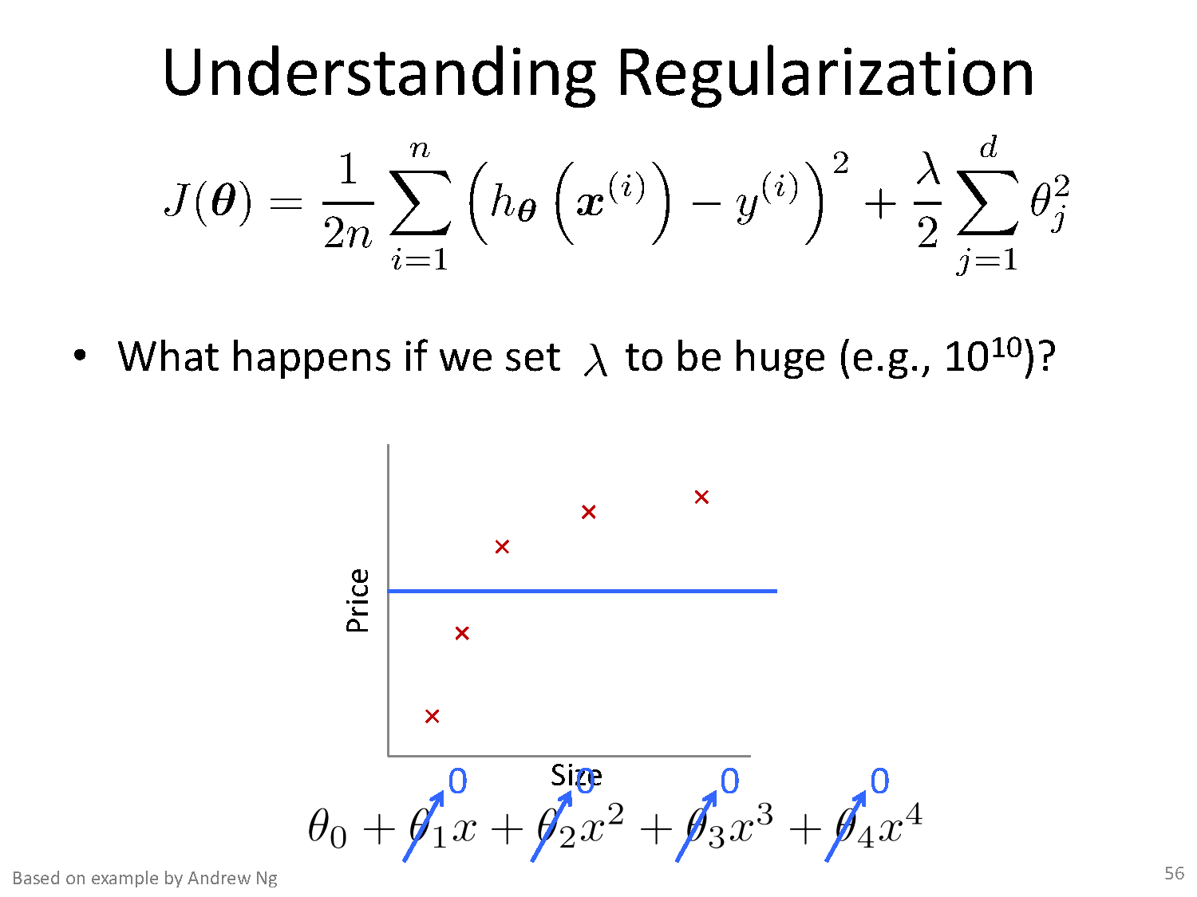
If λ too high
model will be simple,
risk of underfitting the data
model won't learn enough about the training data to make useful predictions
If λ too low
more complex model,
risk of overfitting your data.
model will learn too much about the particularities of the training data, and won't be able to generalize to new data

Slide 42
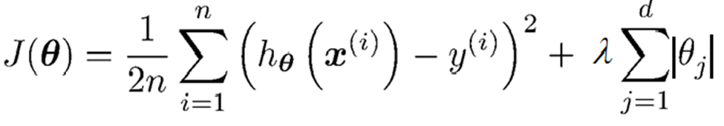



Regularization Lasso Regression (Least Absolute Shrinkage and Selection Operator Regression) –L1
Cost function:
Fit solving $\min{j(θ)}$
Gradient updates

Slide 43



Regularization
Elastic Net
+ r
Control the regularization using the Mix Ration “r”:
When,
r = 1, Elastic Net is equivalent to Ridge Regression,
r = 0, it is equivalent to Lasso Regression
from sklearn.linear_model import ElasticNet
ElasticNet(alpha=0.1, l1_ratio=0.5)

Slide 44
How to choose the right Regularization?
Common Usage & Observation
L1 regularization has the ability to set some coefficients to 0 exactly leading to a sparse model
L1 regularization helps in feature selection by eliminating the features that are not important
L1 cannot be used efficiently in gradient-based approaches since it is not-differentiable unlike L2
L2 will in general lead to small magnitudes of weights but not exactly 0.
Elastic net – Prefer in Highly correlated features

Slide 45

Numerical Exercise – For Student Practice
Fit a linear regression. Show only the first iteration of Gradient descent algorithm using learning rate of 0.02 for the following data , if the Relative Risk of Coronary Heart Disease is believed to be only linearly dependent on BMI as well as Diastolic Pressure. Assume the intercept of the regression model as 5 and the slope of independent variables as -0.03 (negative).
Apply a regularization on the same problem with regularization constant 5 and apply GD for 2 iterations & interpret the results. Try both ridge regression as well as lasso regression. Below equation is changed only for ridge regression. Students must apply appropriate GD update equation changes for this problem.
Steps :
Identification of the equations y = w0+w1X1+W2X2
Cost function & derivative
W0` = w0 – 1/3 * learning rate * (sum (w0+w1X1+W2X2 - y))
W1` = w1* (1- learning rate * regularization constant) – 1/3 * learning rate * (sum (w0+w1X1+W2X2 - y) * x1)
W2` = w2 * (1- learning rate * regularization constant) – 1/3 * learning rate * (sum (w0+w1X1+W2X2 - y)*x2)
Apply the equations

Slide 46
References
https://cs229.stanford.edu/lectures-spring2022/main_notes.pdf
Pattern recognition and machine learning, Christopher bishop - CH3
PANG-NING TAN, MICHAEL STEINBACH, VIPIN KUMAR, Introduction To Data Mining, Pearson, 2nd Edition

